Slide 1

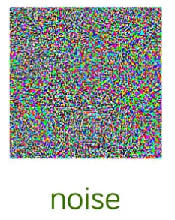
Adversarial attacks & Examples on medical imaging
Chris, Fudan University

Slide 2
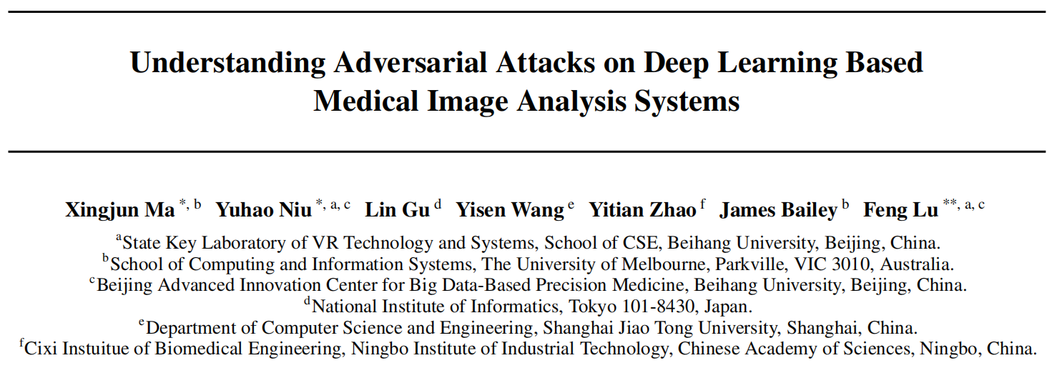
Adversarial attacks on
medical machine learning
Samuel G. Finlayson, John D. Bowers, Joichi Ito, Jonathan L. Zittrain, Andrew L. Beam, Isaac S. Kohane

Slide 3
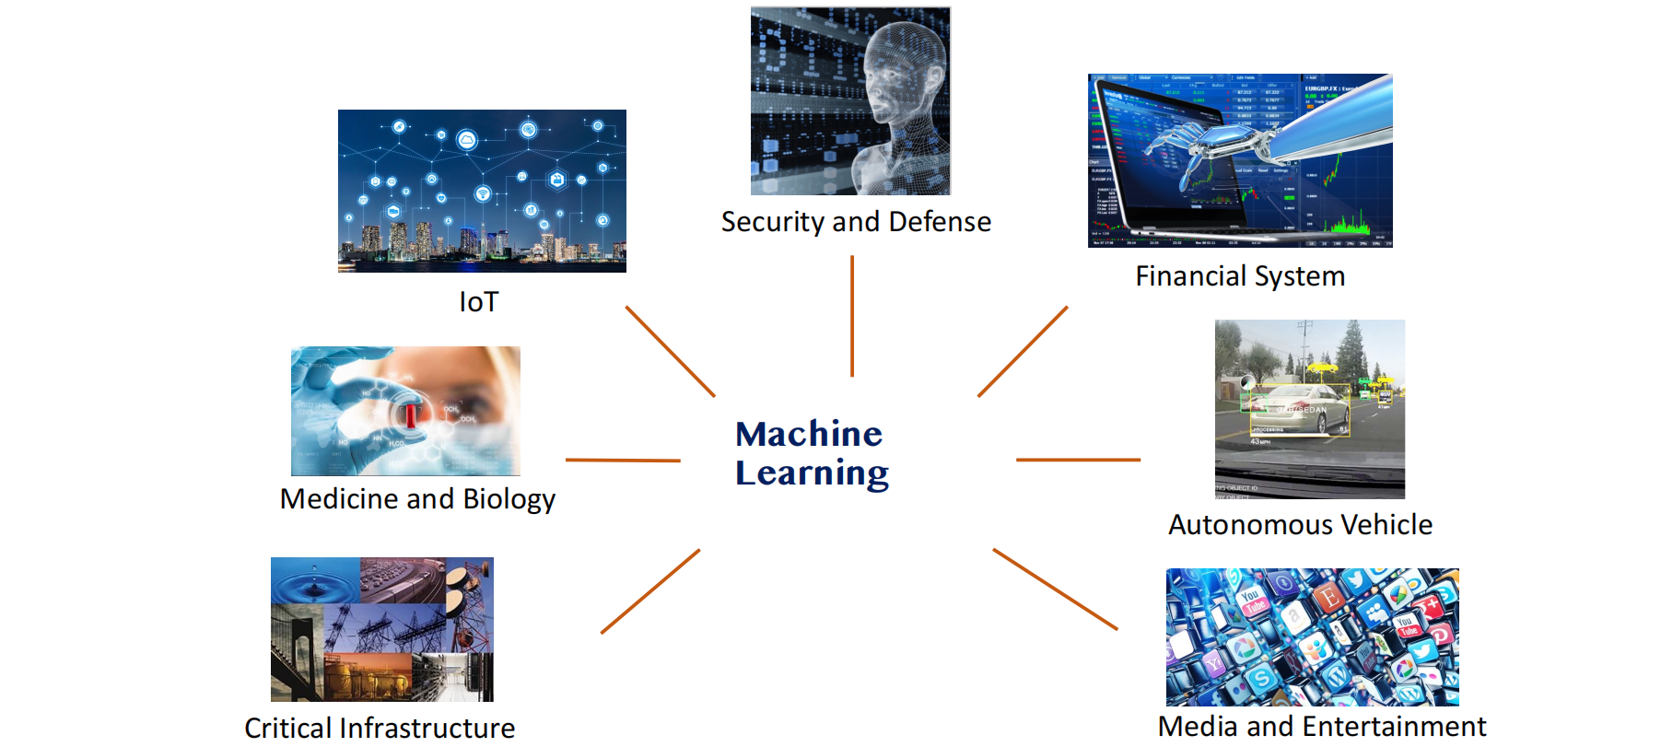
Machine Learning Applications
Notes:
预训练语言模型的发展
自Transformer模型以来，预训练语言模型架构可以被分为三类
纯编码器结构、编码器-解码器结构、纯解码器结构
2021 年之后，随着改变游戏规则的 GPT-3 的推出，纯解码器模型逐渐主导了 LLM 的发展，纯编码器模型逐渐开始淡出市场

Slide 4
Capabilities vs Humans
Strategic Games
AlphaGo:
first Computer Program to Beat a Human Go Professional
Training DNNs: 3 weeks, 340 million training steps on 50 GPUs
Play: Asynchronous multi-threaded search
Simulations on CPUs, policy and value DNNs in parallel on GPUs
Single machine: 40 search threads, 48 CPUs, and 8 GPUs
Distributed version: 40 search threads, 1202 CPUs and 176 GPUs
Outcome: Beat both European and World Go champions in best of 5
matches
Notes:
预训练语言模型的发展
自Transformer模型以来，预训练语言模型架构可以被分为三类
纯编码器结构、编码器-解码器结构、纯解码器结构
2021 年之后，随着改变游戏规则的 GPT-3 的推出，纯解码器模型逐渐主导了 LLM 的发展，纯编码器模型逐渐开始淡出市场

Slide 5
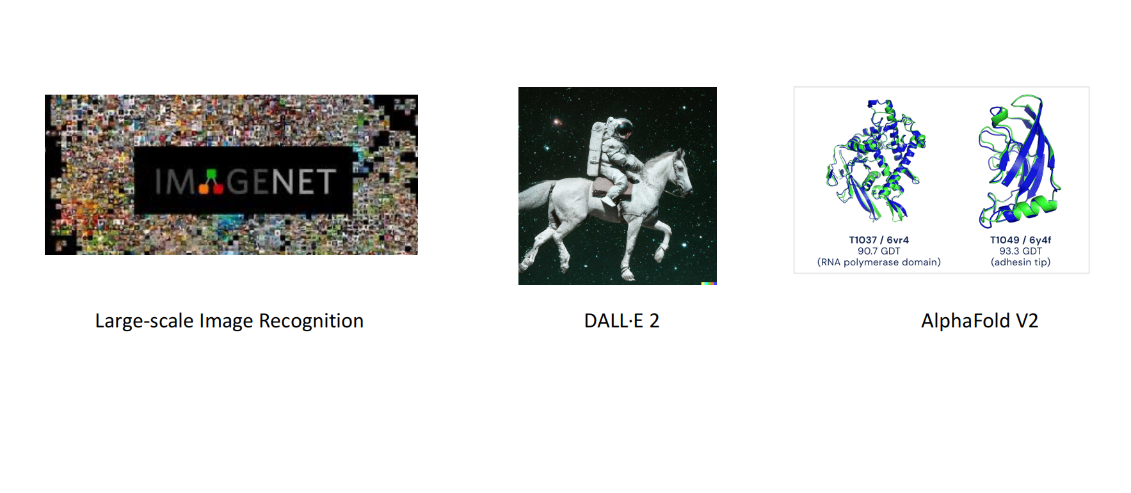
Capabilities vs Humans

Slide 6




Capabilities vs Humans

Slide 7
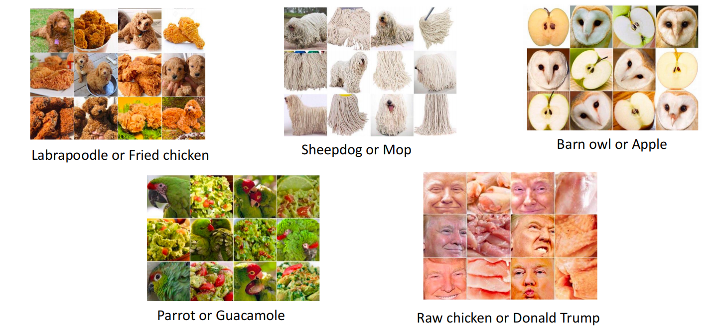
Capabilities vs Humans (Image Recognition)
GoogLeNet: https://cs.stanford.edu/people/karpathy/ilsvrc/

Slide 8
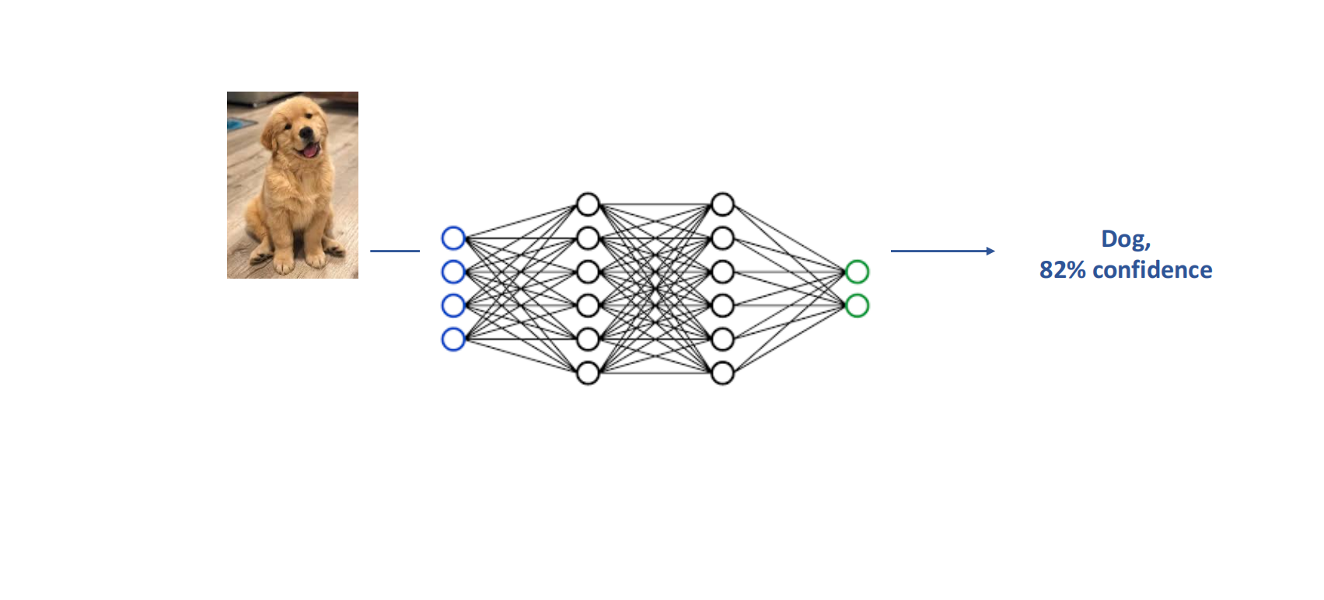
Vulnerabilities of DNNs

Slide 9
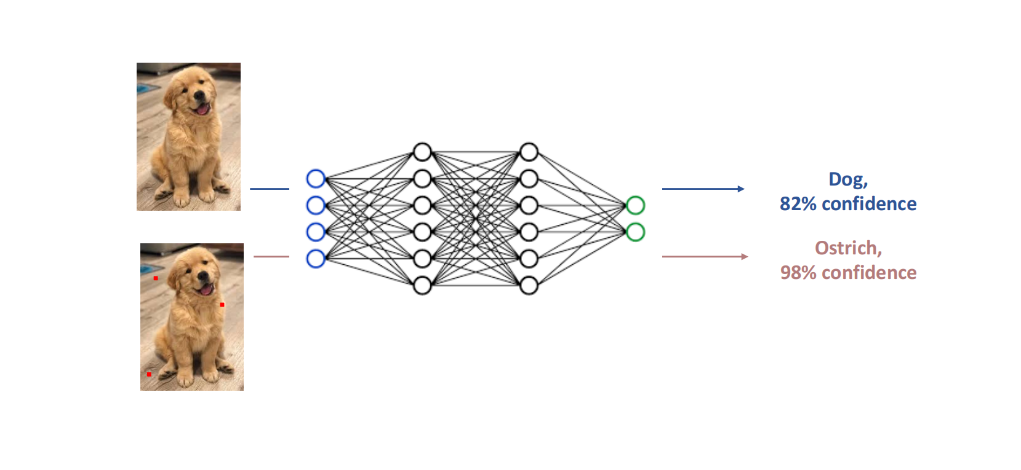
Vulnerabilities of DNNs

Slide 10
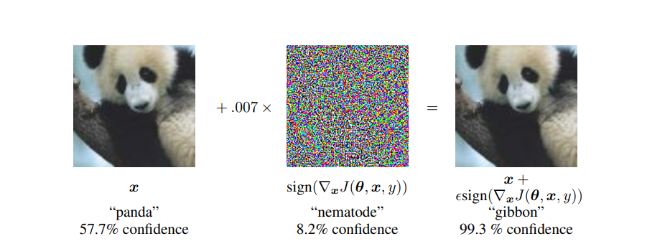
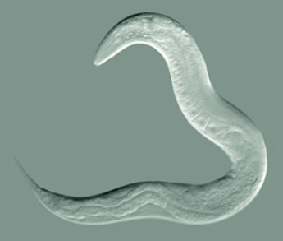

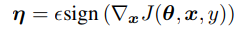
Adversarial Examples
By adding an imperceptibly small vector whose elements are equal to
the sign of the elements of the gradient of the cost function with respect to the input, we can change the img classification
θ = parameters of a model,
x = input to the model,
y = the targets associated with x
J(θ, x, y) = be the cost used to train the neural network.
We can linearize the cost function around the current value of θ, obtaining an optimal max-norm
constrained pertubation of;
∇xJ(θ,x,y): Gradient of loss with respect to input.
Small perturbations can fool DNNs

Slide 11
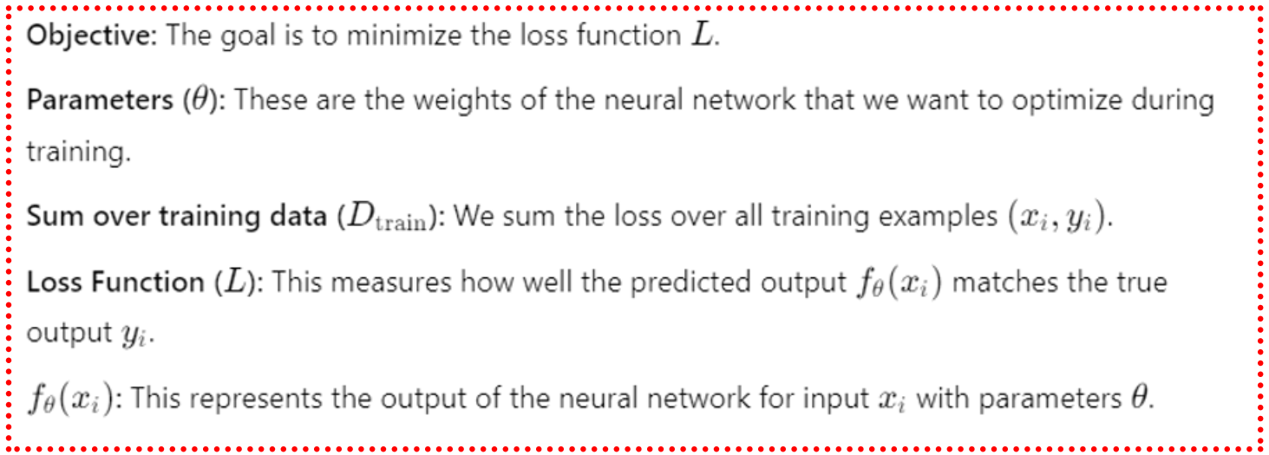
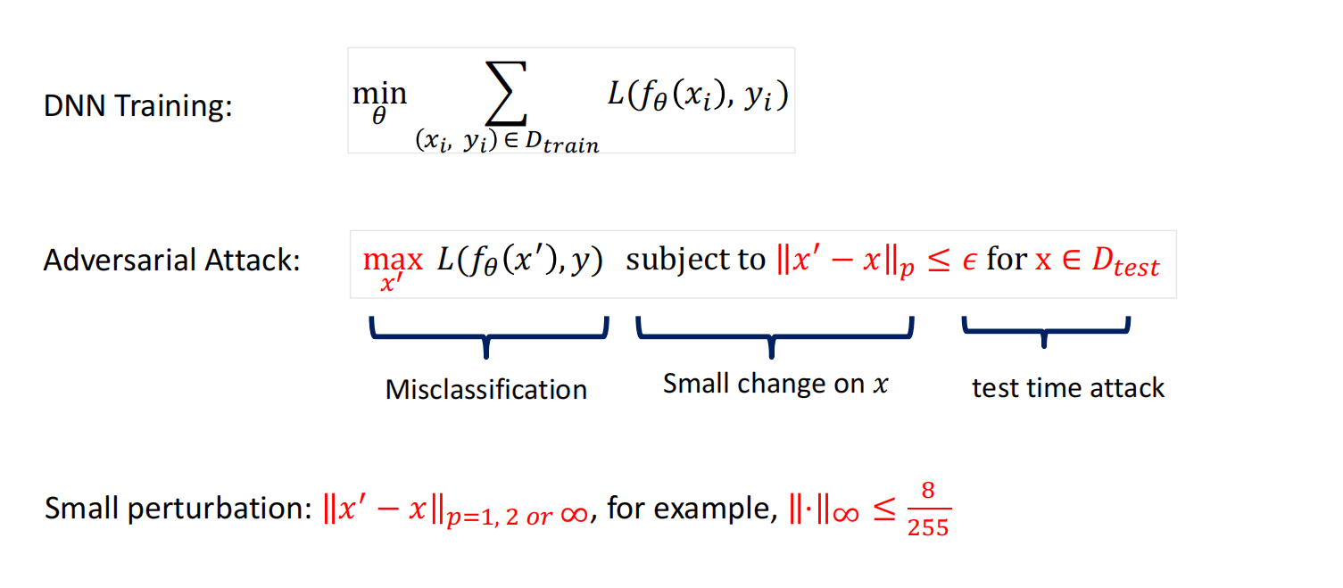
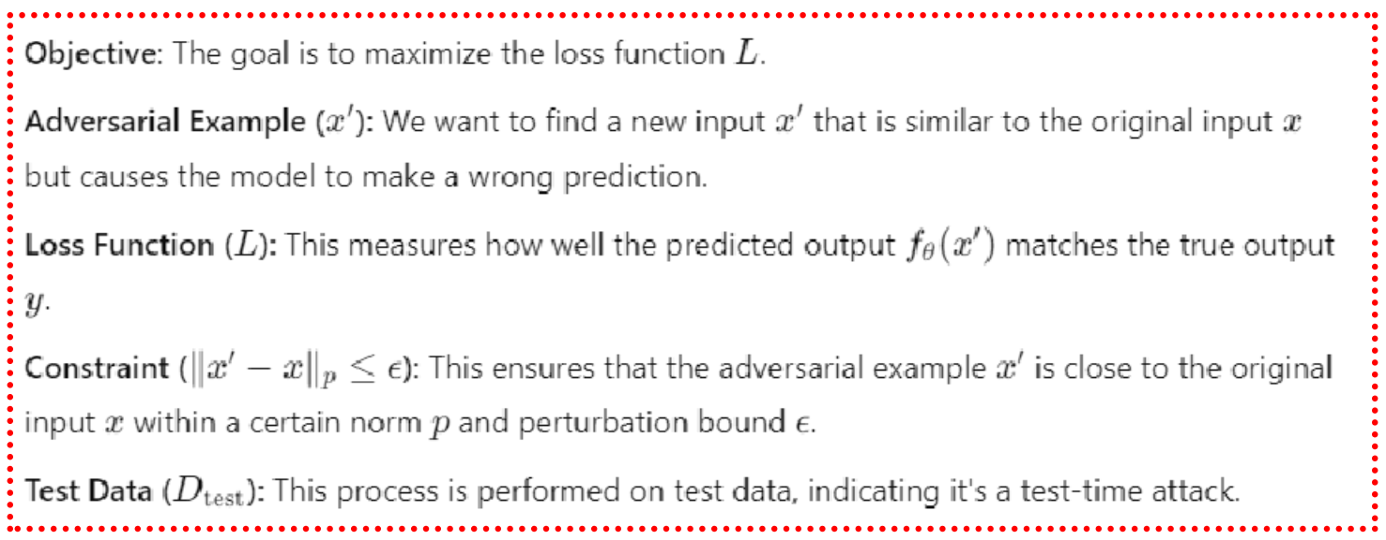
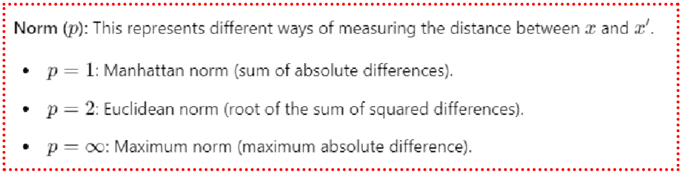
Adversarial Attack
https://arxiv.org/pdf/2203.10502

Slide 12
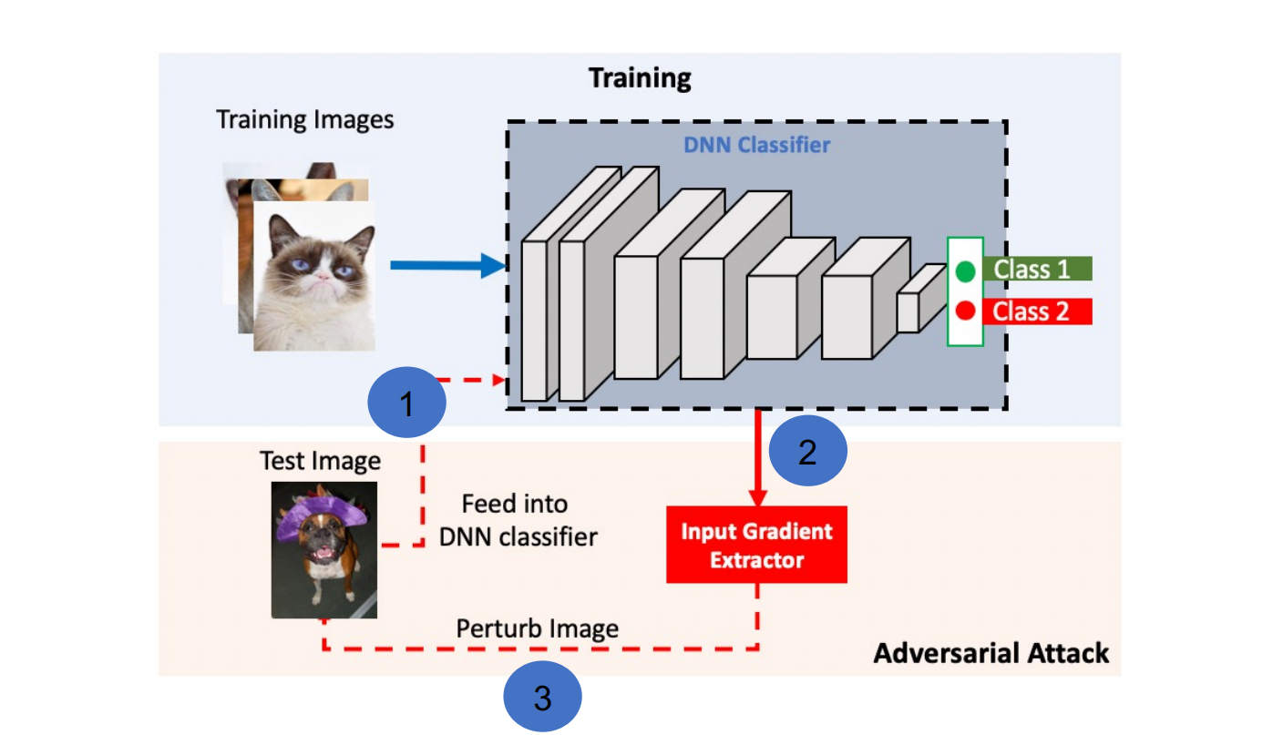
Adversarial Attack
The pipeline of training DNNs and generating adversarial attacks

Slide 13
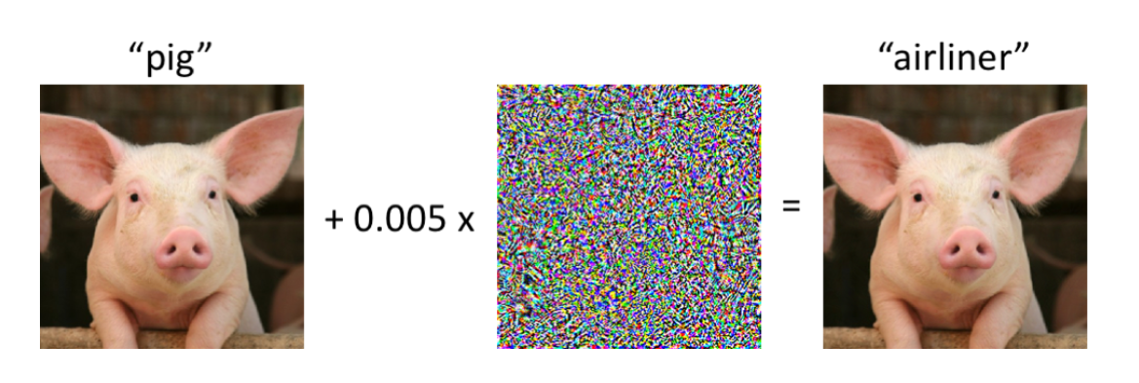
Characteristics of Adversarial Examples
Small
Imperceptible
Hidden
Transfer
Universal
noise

Slide 14
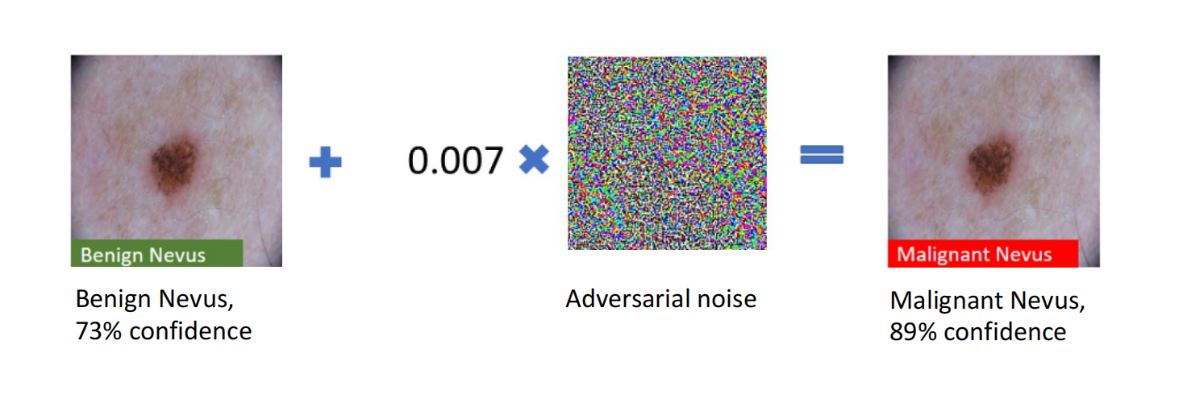
Example Attacks
Perturbations are small, imperceptible to human eyes.
Adversarial examples are easy to generate and transfer across models.

Slide 15
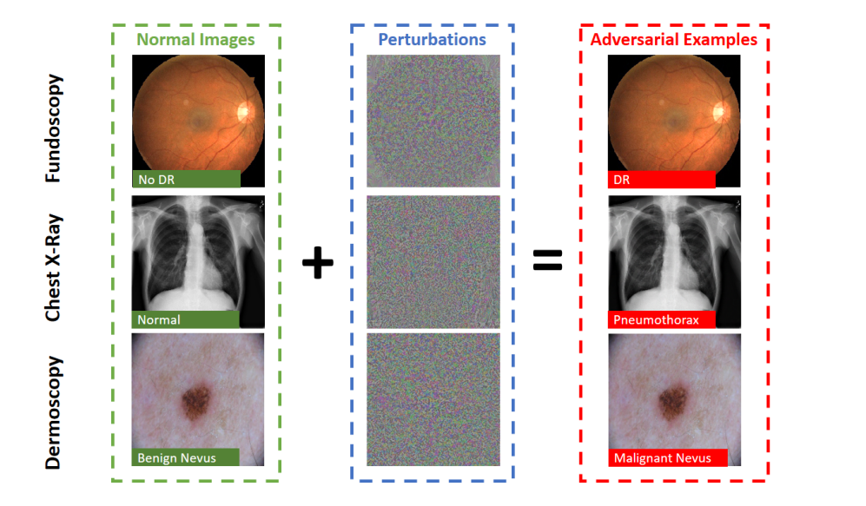
Example Attacks
Examples of adversarial attacks crafted by the Projected Gradient Descent (PGD) to fool DNNs trained on medical image datasets Fundoscopy (Kaggle, 2015) (first row, DR=diabetic retinopathy), Chest X-Ray (Wang et al., 2017)

Slide 16
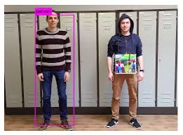
Example Attacks
Adversarial patch makes people invisible to object detection (YOLO)

Slide 17
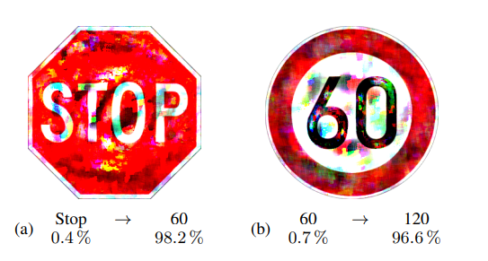
Example Attacks
goal of the adversary is to generate a perturbation that fools the TSR system into predicting a Stop sign as a Speed Limit 60 sign
https://arxiv.org/pdf/2302.13570

Slide 18
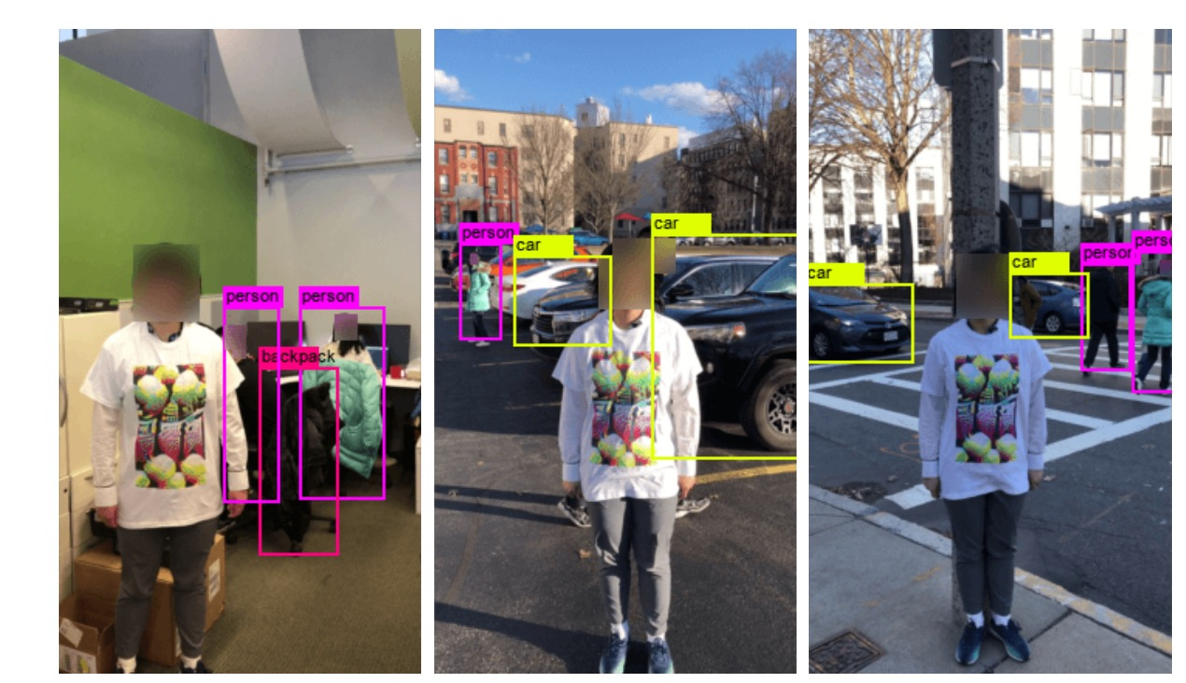
Example Attacks
Adversarial t-shirt: one step closer to real-world attack

Slide 19
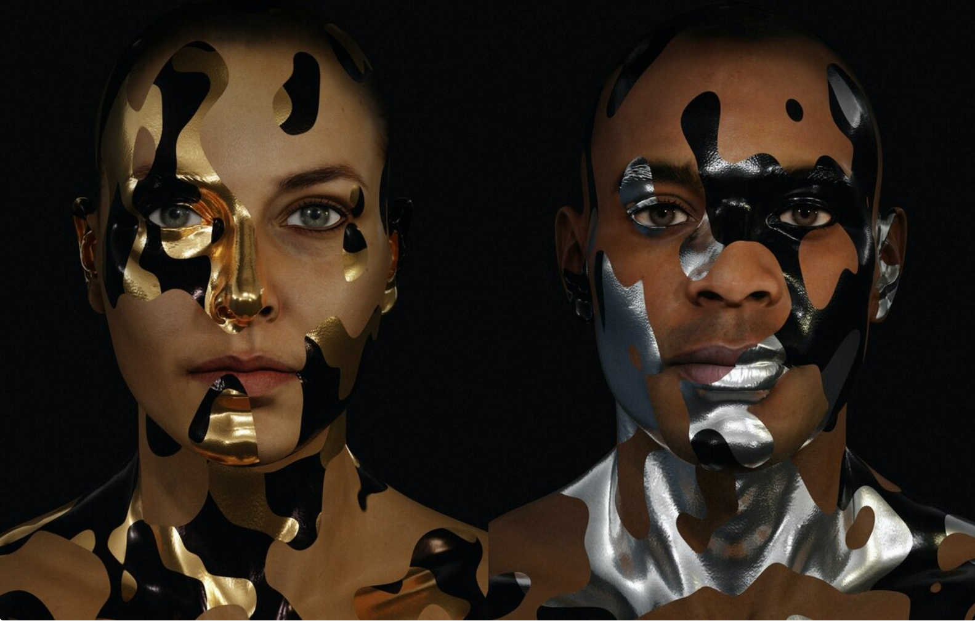

Example Attacks
Unrecognizable to most SOTA detection alg
https://adam.harvey.studio/cvdazzle

Slide 20
Threats to AI Applications
Transportation industry: trick autonomous vehicles into misinterpreting stop signs or speed limit
Cybersecurity industry: bypass AI-based malware detection tools
Medical industry: forge medical condition
Smart Home industry: fool voice commands
Financial Industry: trick anomaly and fraud detection engines

Slide 21
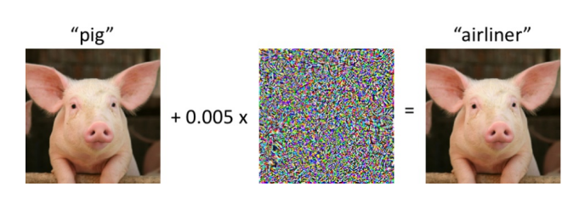
So, what are Adversarial Examples?
“Adversarial examples are inputs to machine learning models that an attacker has intentionally designed to cause the model to make a mistake”
“Adversarial examples are inputs to a machine learning model that are intentionally crafted to force the model to make a mistake” Finlayson et al
Adversarial Examples Are Not Bugs, They Are Features. Ilyas et al
https://arxiv.org/pdf/1905.02175

Slide 22
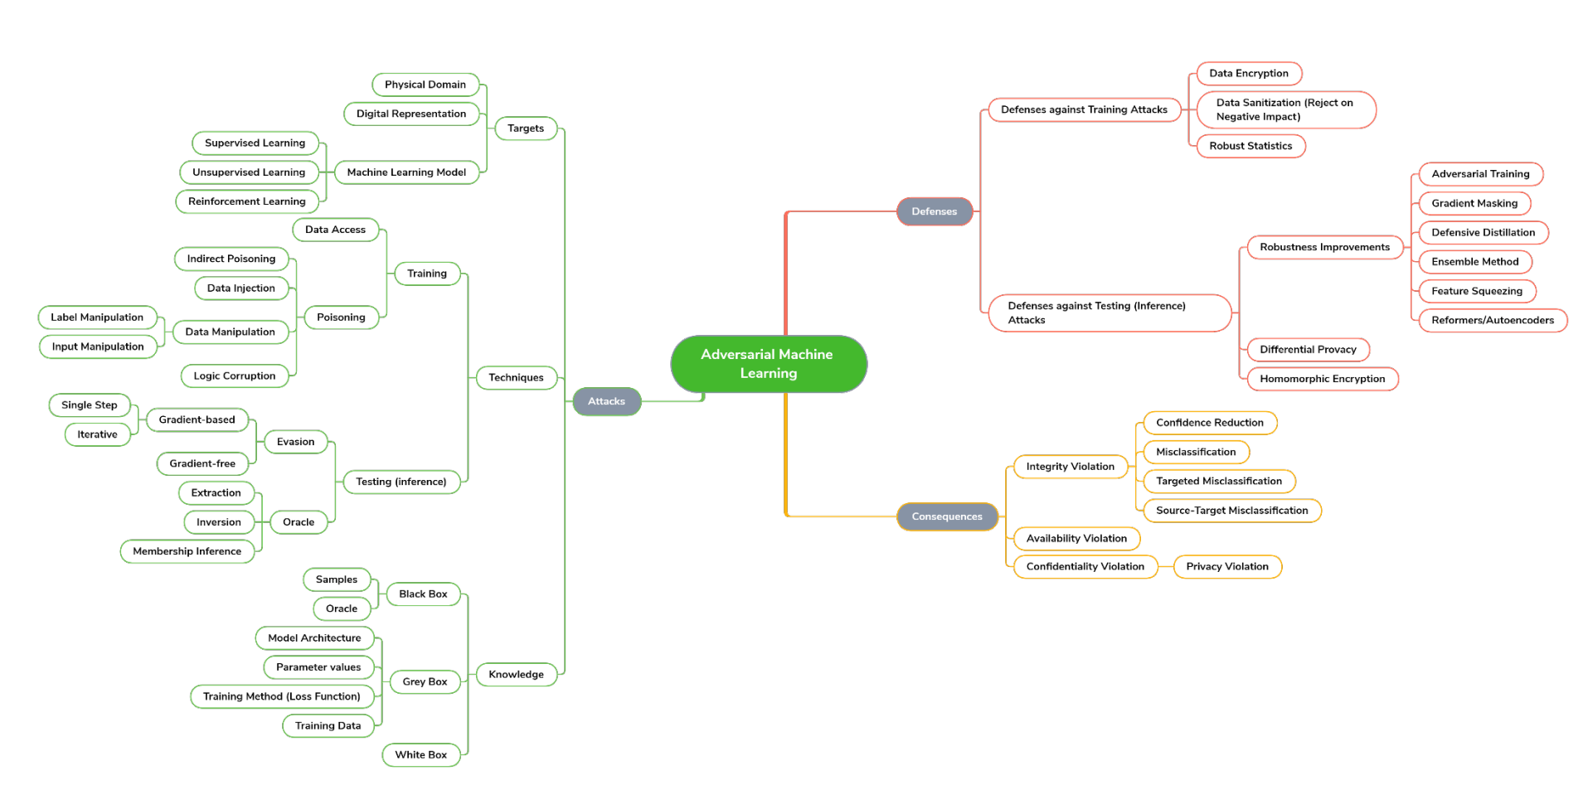
Taxonomy of Attacks, Defenses, and Consequences in Adversarial Machine Learning
https://csrc.nist.rip/external/nvlpubs.nist.gov/nistpubs/ir/2019/NIST.IR.8269-draft.pdf

Slide 23
Taxonomy of Attacks
Attack timing
– Poisoning attack
– Evasion attack
Attacker’s goal
– Targeted attack
– Untargeted attack
Attacker’s knowledge
– Black-box
– White-box
– Gray-box
Universality
– Individual
– Universal

Slide 24
Attack Timing
Evasion (Causation) attack
Test time attack
Change input example
Poisoning attack
Training time attack
Change classification boundary

Slide 25
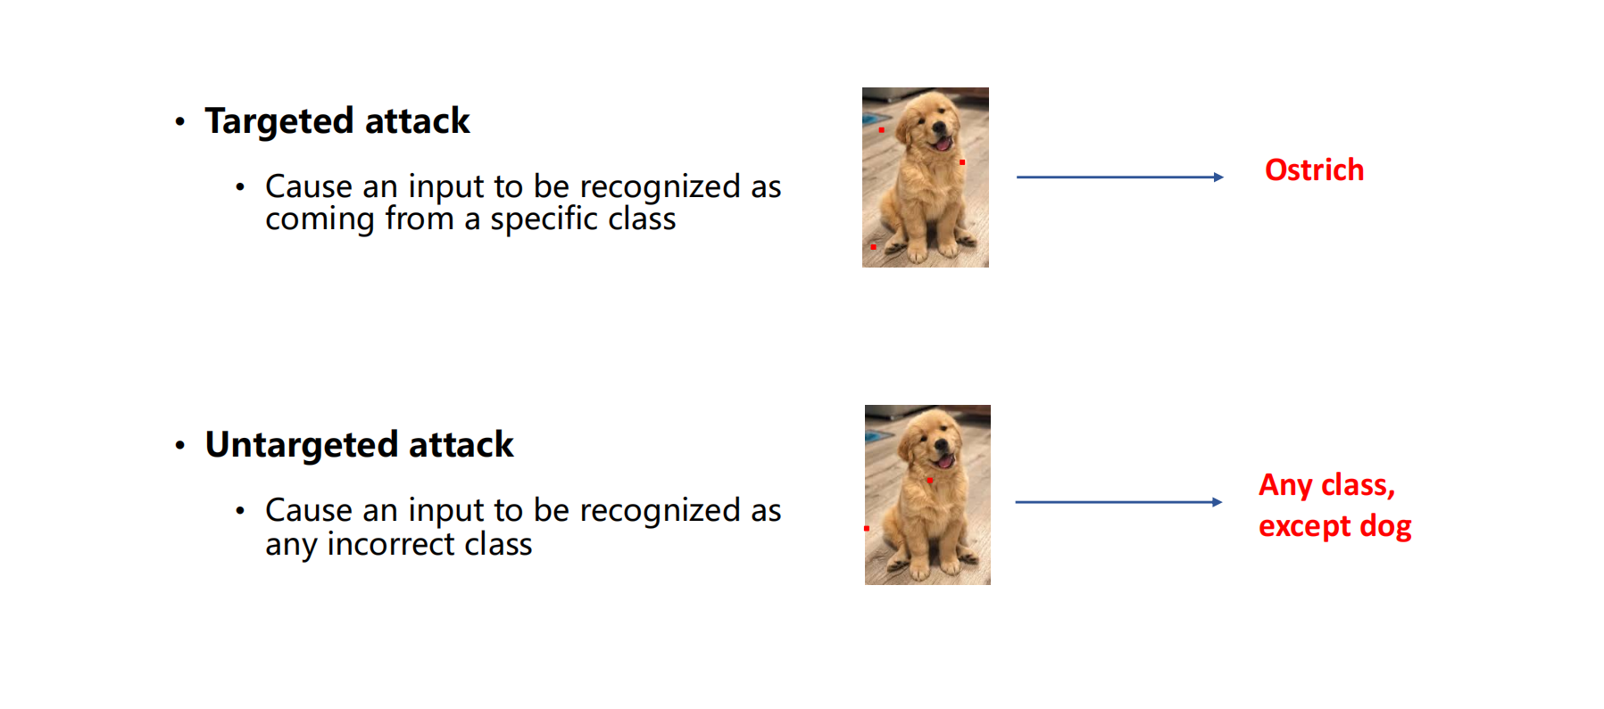
Attacker's Goal

Slide 26
Attacker’s knowledge
White-box attack
Attacker has full access to the model, including model type, model architecture, values of parameters and training weights
Black-box attack
Attacker has no knowledge about the model under attack
Rely on transferability of adversarial examples
Gray-box attack (Semi-black-box attack)
Attacker may know some hyperparameters like model architecture

Slide 27
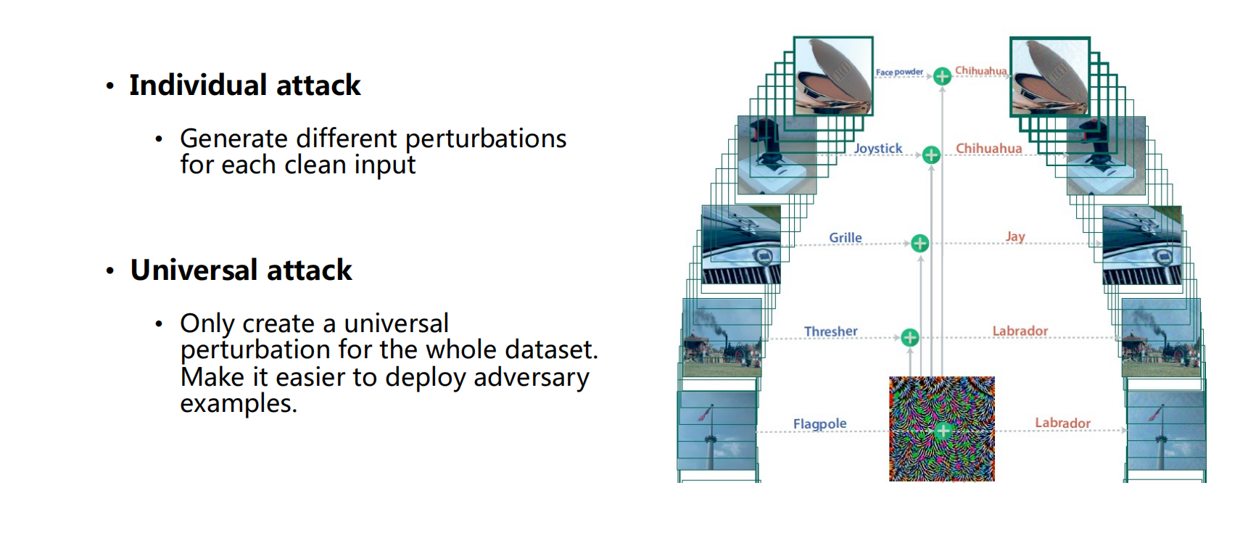
Universality

Slide 28
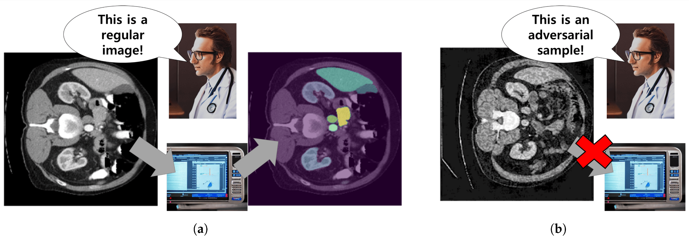
Adversarial attacks on medical machine learning
In medical diagnostics and decision support, machine-learning systems appear to have achieved diagnostic parity with physicians on tasks in radiology, pathology, dermatology (skin), and ophthalmology (eyes) . In 2018, the U.S. Food and Drug Administration (FDA) approved marketing for the first-ever auton_x005F_x0002_omous artificial intelligence (AI) diagnostic system
(a) A standard CT image smoothly interacts with the automatic segmentation system, while (b) a conspicuous noise makes an adversarial sample, introduced by an intruder, readily noticeable to a healthcare practitioner.
https://www.mdpi.com/2076-3417/14/6/2576

Slide 29
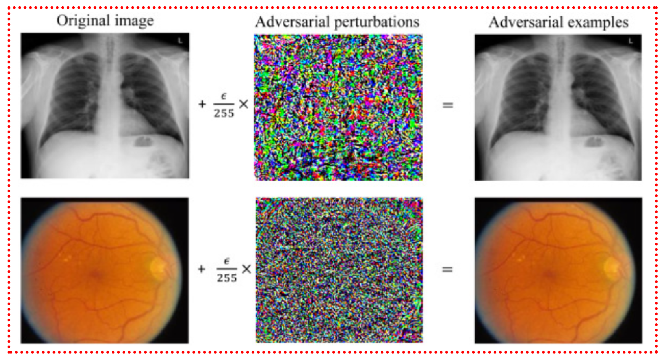
Adversarial attacks on medical machine learning
ML systems vulnerabilities allow a small, carefully designed change in how inputs are presented to a system to completely alter its output, causing it to confidently arrive at manifestly wrong conclusions. These advanced tech_x005F_x0002_niques to subvert otherwise reliable ma_x005F_x0002_chine-learning systems—so-called adversarial
attacks—have, to date, been of interest primarily to computer science researchers (1).
However, the landscape of often-competing
interests within health care, and billions of
dollars at stake in systems’ outputs, implies
considerable problems.
the adversarial noise added to the image is not random and has near-zero probability of occurring by chance
https://www.sciencedirect.com/science/article/pii/S0031320322004046

Slide 30
Challenges of adv attacks in healthcare
adversarial attacks represent an intriguing new challenge. because they afford users of an algorithm the ability to influence its behavior in subtle, impactful, and sometimes ethically ambiguous ways. Deliberately crafting a noise-based adversarial example targeting a visual diagnostic algorithm, would amount to overt fraud.
this is not a problem specific to medicine, and every domain of machine-learning application will need to contend with it.
no individual human can definitively assign the true label between, say, “benign” and “cancerous” on a photograph of a mole. This could enable bad actors to selectively perturb borderline cases without easy means of review, consistently nudging scales in their direction.

Slide 31
EXISTING ADVERSARIAL BEHAVIOR
Billions of medical claims are processed each year, with approvals and denials directing trillions of dollars and influencing treatment decisions for millions of patients. In addition to dictating the availability of patient care, claims approval is vested with competing financial interests, with providers seeking to maximize and payers seeking to minimize reimbursement medical claims, it is unsurprising that many providers engage in creative and often fraudulent practices to increase their revenue
Medical claims codes determine reimbursement for a patient visit after they have been approved by a payer. To evaluate these claims, payers typically leverage automated fraud detectors, powered increas_x005F_x0002_ingly by machine learning. Health care providers have long exerted influence on payers’decisions (the algorithmic outputs) by shaping their records (and accompany_x005F_x0002_ing codes) of patient visits

Slide 32
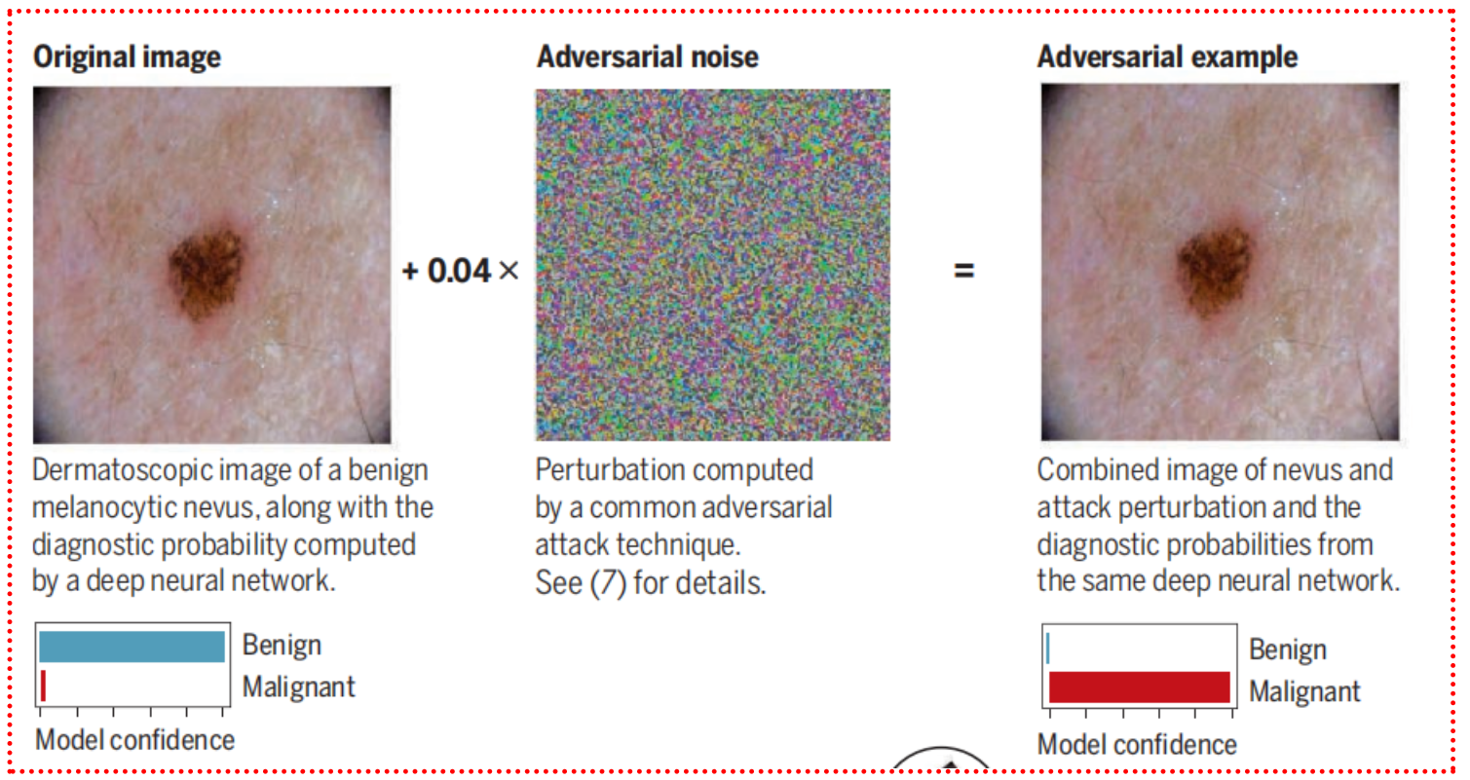
Attacks against medical AI systems
adversarial attacks against various medical AI systems might be executed without requiring any overtly fraudulent misrepresentation of the data.

Slide 33
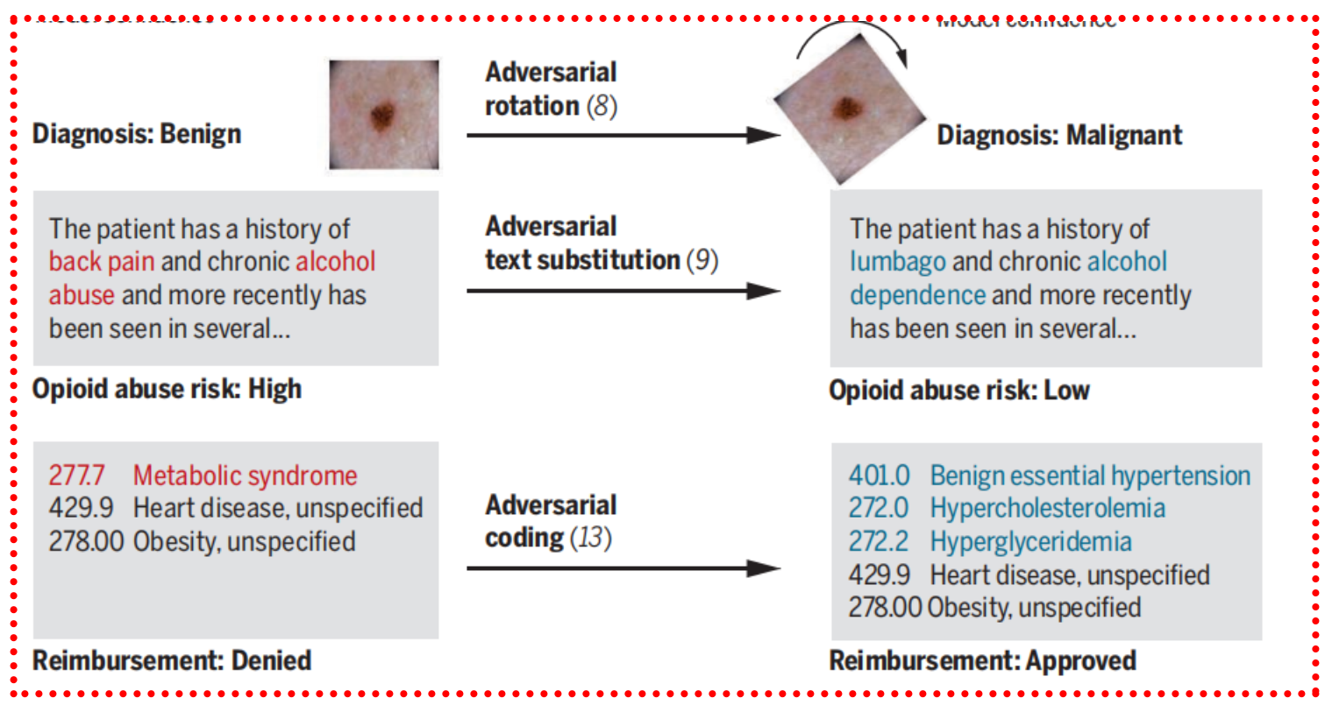
Attacks against medical AI systems
At the extreme of this tactical shaping of a patient presentation is medical fraud, a $250 billion industry

Slide 34
Attacks gray zone
In other circumstances, subtle billing code adjustments fall within a gray zone between fraud and well-intentioned best practices. In one striking example, the website of the Endocrine Society recommends that providers do not bill for the International Classification of Diseases (ICD) code 277.77 (metabolic syndrome) in patients with obesity, as this combination of code and condition is likely to result in a denial of coverage (13). Instead, the Society recommends billing for codes corresponding to specific diseases that make up metabolic syndrome, such as hypertension. In other words, providers are not encouraged to add fraudulent claims but are encouraged to avoid adding a true claim that an insurance company would be likely to reject in combination with another.
Is this practice ethical?_x005F_x0002_

Slide 35
applications of adversarial attacks in the medical context go far beyond insurance fraud, encompassing a spectrum of motivations;
desire to provide high-quality care
drug and device approvals
bias trial outcomes in attackers favor
“adjust” borderline trial results for products that might save lives.

Slide 36
The road ahead
An essential question remains: when and how to intervene.
“procrastination principle”: Should the adversarial-examples problem in health care systems be addressed now in the early, uncertain days of medical AI algorithms—or later, when algorithms and the protocols governing their use have been firmed up?
Advantages
At best, acting now could equip us with more resilient systems and procedures, heading the problem off at the pass
Disadvantages
At worst, it could lock us into inaccurate threat models and unwieldy regulatory structures,
stalling developmental progress and robbing systems of the flexibility they need to con_x005F_x0002_front unforeseen threats.

Slide 37
Summary
The coalescence of strong motives to manipulate algorithms and the rapid proliferation of algorithms vulnerable to manipulation makes health care a plausible ground zero for the emergence of adversarial examples into real-world practice.
As adversarial examples emerge across a range of domains, we will have to make choices again and again about whether and how to intervene early at the risk of stifling development, and how to balance the promises of ubiquitous machine learning against liabilities imposed by these emerging vulnerabilities.
The stakes will remain high—autonomous vehicles and AI-driven weapons systems will be just as susceptible. A clear-eyed and principled approach to adversarial attacks in the health care context—one which builds the ground_x005F_x0002_work for resilience without crippling rollout and sets ethical and legal standards for line_x005F_x0002_crossing behavior—could serve as a critical model for these future efforts.

Slide 38

Demo

Slide 39
Thanks！

